Slide 1

WAIŪ– A Celebration Of Sharing Happiness

Slide 2








Truevibez Pvt. Ltd. : An Overview
Initiative
Truevibez was established in 2020 with aim to focus on modernization of hospitality industry, by introducing innovative products & features driven by technology evolution.
Mission
To create a global service provider of hospitality industry, realizing pioneering advancements in established services and accomplish mutual growth for both our partners & customers
Programs
Truevibez have designed pioneering programs under WAIU umbrella, which will drive inventive & original business solutions for both our restaurant partners & consumers for mutual benefit & success.

Slide 3
Founder : Rajesh Karandikar
Rajesh Karandikar is owner of Hotel 24K chain of restaurants in Maharashtra (MH) & Director of Truevibez Pvt. Ltd.
Rajesh is a government media partner as an empanelled member of DGIPR & has executed a range of promotional and awareness campaigns such as:
Edutainment program for Primary & Secondary school in collaboration up with Discovery channel
Cloud seeding program across MH in 2018 under Ministry of Earth Sciences
Executed disaster management week with NDRF for government offices & schools, in 463 tehsils
Rajesh holds MBA in Marketing stream & after spending time at several corporate positions in Delhi, Mumbai & Pune, he applied his entrepreneurial skills in hospitality industry and started the Hotel 24K chain of restaurants, originating in Kolhapur, Maharashtra.
The implementation was an instant success, something which he has now replicated in Pune at premium locations as Balewadi High Street & Viman Nagar IT City. With 3 active restaurants now, Rajesh is also enrolled as an honorary member of Craft Brewers Association of India, successfully running a Craft Brewery in Pune.
To extend his expertise further in hospitality business, Rajesh has founded company Truevibez Pvt. Ltd., with Alok Sambuddha, that aims to explore and introduce innovative technology solutions in hospitality industry to take customer experience to completely new & unexplored levels.

Slide 4
Founder : Alok Sambuddha
Alok Sambuddha is Engineering Director in American Express, United Kingdom & Director of Truevibez Pvt. Ltd.
Alok is a Mechanical Engineer from Pune University with broad experience in IT industry, working with prominent MNCs as Cisco, Infosys, Atos and now American Express.
Alok’s specializes in merchant acquisition domain and developing technical platforms to support end to end merchant lifecycle services such as affiliation, enablement, submissions, payments, reconciliation, compliance, MIS, AML, Risk, Finance & Accounting.
He also leads solution development framework across technologies like Mainframes, Java, Dot Net, supported via both Agile & Waterfall delivery models. He provides corporate and architectural consultation to business & technology teams to develop flexible solution frameworks & heads the implementation committee.
Alok’s primary geography of operation is Europe (EMEA) and has spent most of his career in Brighton, UK, at the European technology head office of American Express.
Alok has critical presence in merchant management landscape and aims to extend his experience through technical evolution of traditional hospitality business and modernize the F&B service offering for digital citizens in partnership with Rajesh Karandikar.

Slide 5
WAIŪ : Vision & Key Features
Vision:
To create a global service provider of hospitality industry, realizing pioneering advancements in established services and accomplish mutual growth for both our partners & customers
Next Level Hospitality Service Offerings
WAIU aims to introduce industry first features in hospitality, keeping the best interest of Restaurant owners and their underserved staff in mind, not just the customers. Key services offered by WAIU are:
Phase One:
Eat Now-Pay Later for restaurant F&B customers
Restaurant staff financial lending for their important needs
Phase Two: Following Phase One stabilization in 10 cities
Interactive media performances at partner restaurant venues
Logistics & Governance to address some of restaurant’s major issues & improvement areas
Socializing & Gaming in premises of restaurant, to promote interaction and upsell
Pre-paid Point Based Services (PBS)

Slide 6



WAIU – Flagship Program of Truevibez
Clique is premium service offered to our finest customers & business partners, to mutually benefit through means of microfinancing services.
Dine Now, Pay Later
For customer expecting an event to visit restaurant but without available liquid funding, Clique will open up a line of credit in handshake with a lender (NBFC). The customer can request this restaurant-focused credit line and once approved, use it at any partner restaurant. Piloting with 200 restaurants in Pune, we aim to expand to 10 key cities by EOY and have 3000 restaurant partners by 2023.
Merchant Staff Financial Lending
Restaurant staff currently face many challenges in requesting loans from banks and NBFCs however from recommendation of a partner merchants, a low-medium size credit pool will be made available to them with flexible repayment options.
With microfinance market anticipated to grow with CAGR of 40% through 2025, NBFC-MFIs will be its greatest beneficiaries. In F&B segment, unbanked microlending has only reached 12-15% of the prospective market.

Slide 7
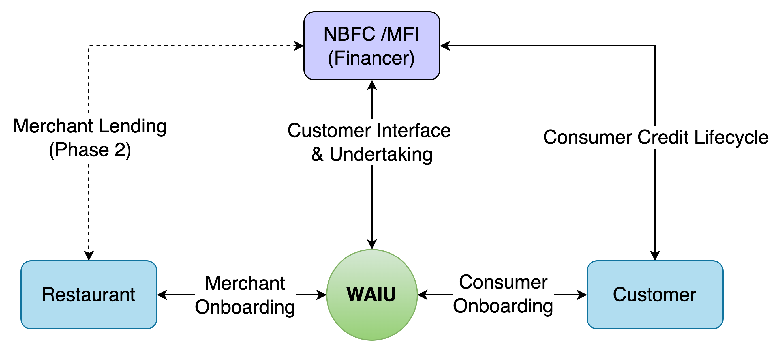
WAIU – High Level System Flow
WAIU pilot is planned in Pune, Maharashtra in March-2022, with in initial partnerships with 200 top restaurants.
By end of 2022, WAIU will be expanded in 10 key cities across India, with a partner merchant base of 3000+
Each restaurant to have average of 5000+ customers per restaurant, allowing a significant solution coverage
Platform development is complete with merchant signup & brand positioning and collaterals in design
WAIU will expand to Tier-2 cities by end of 2022, to support its NBFC partners already operational there
Wider WAIU Phase-2 features, including merchant lending, will be launched in Q3 2022.

Slide 8
Budweiser – Impacts & Benefits
Increased visibility
In premium WAIU partner restaurants would increase Budweiser client conversions Pan-India
Long Term Agreement
With WAIU as an upcoming restaurant aggregator would benefit Budweiser recognition & acceptance, throughout the sharp growth curve of WAIU
Increased Client Count
To be benefitted from 3000+ premium WAIU restaurants partners by Q2 2023
Increased Sales
Even with only 10% conversion rate, Budweiser can bring sale volume of additional Rs 3CR, by Q1 2023.
This could be 10CR, by Q1 2024.
High Customer Retention
Through advertisement on WAIU app nationally to 6.5Cr+ customers
Events & Promotions
Co-hosted events like Budweiser-WAIU events (music, comedy, gaming, dance ) at WAIU restaurants will provide great brand recognition

Slide 9
Our Team
Promoters
Rajesh Karandikar
Alok Sambuddha
Board Of Advisors
Suhas Gokhale : Managing Director, COSMOS Bank, Pune
Rahul Renavikar :Managing Director, Acuris Advisors (GST & Government Policies) – Ex. Big 4 & Tata Motors
Chetan Oswal : Accounts & Legal Counsel
Shrikant Chatur : Governance Consultant (ex. VP Commercial - Cummins)
Sanjay Phadke : Fintech Specialist, Ex. EVP Edelweiss & Vayana Network, JP Morgan, HSBC
Rakesh Malhotra : Media Curator, Ex. Media Head - Sakal
Yogesh Katre : Sales Head, Loantap
Harun Rashid Khan : Regulatory Advisor, Ex. Deputy Governor RBI
Vinay Baijal : Regulatory Advisor, Ex. CGM Banking, RBI

Slide 10






Question & Answers
Rajesh Karandikar : +91 98507 88899
RajeshKarandikar@hotel24k.com
Alok Sambuddha : +91 80800 71197
Alok.Sambuddha@hotel24k.com

